Slide 1
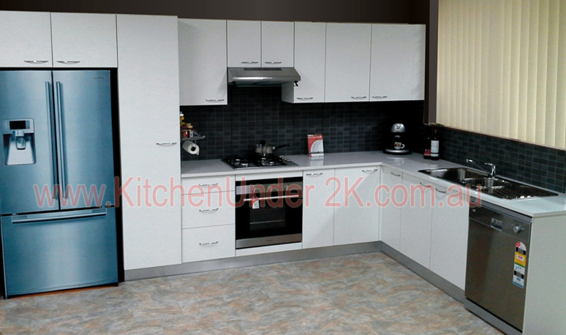
Sydney
Sydney
Discount
Kitchens
Discount
Kitchens
ABN: 43 487 583 720
ABN: 43 487 583 720
FREE INSTALLATION
Our Price $5990
Our Price $5990
Free in home check measure
Free in home check measure
*Conditions Apply
*Conditions Apply
Package Includes
Package Includes
All Kitchen
Installations
fully project
managed from
start to
finish
All Kitchen
Installations
fully project
managed from
start to
finish
Full height PANTRY
Above Fridge CABINET
Full height fridge PANEL
Full height FILLER
20mm Granite BENCHTOP
Base CABINETS
Wall CABINETS
Full height PANTRY
Above Fridge CABINET
Full height fridge PANEL
Full height FILLER
20mm Granite BENCHTOP
Base CABINETS
Wall CABINETS
CALL US TODAY! 0412 572 542
CALL US TODAY! 0412 572 542

Slide 2
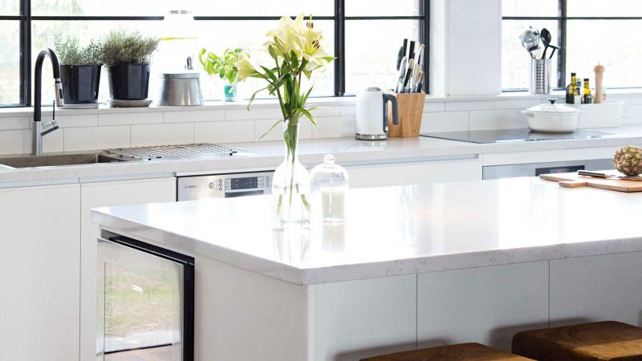
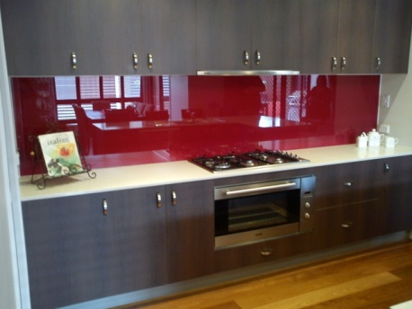
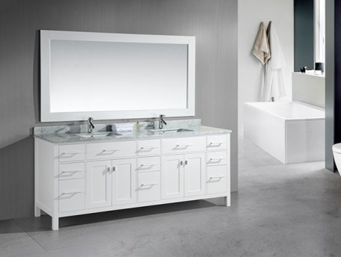
Sydney
Discount
Kitchens
Search
FREE Quote
0412 572 524
Home
About Us
Kitchen Cabinets
Benchtops
Splashback
Gallery
Bathroom Vanities
Contact Us
Glass Splashback
<
All Kitchen
Installations
fully project
managed from
start to
finish
>
Bathroom Vanities
Welcome to Sydney Discount Kitchens
Factory direct prices!
FREE QUOTES – ALL SYDNEY SUBURBS
Enter details for Free inhome quote
Name
Phone
Email
Details
Attach Plans
Send

Slide 3
Sydney
Discount
Kitchens

Slide 4
Sydney
Discount
Kitchens

Slide 5
Sydney
Discount
Kitchens

Slide 6
EOFY Sale
EOFY Sale
FREE INSTALLATION
FREE INSTALLATION
*Conditions Apply
*Conditions Apply
Our Price $5990
Our Price $5990
Package Includes
Package Includes
All Kitchen
Installations
fully project
managed from
start to
finish
All Kitchen
Installations
fully project
managed from
start to
finish
Full height PANTRY
Above Fridge CABINET
Full height fridge PANEL
Full height FILLER
40mm Granite BENCHTOP
Base CABINETS
Wall CABINETS
Full height PANTRY
Above Fridge CABINET
Full height fridge PANEL
Full height FILLER
40mm Granite BENCHTOP
Base CABINETS
Wall CABINETS
CALL US TODAY! 0412 572 542
CALL US TODAY! 0412 572 542

